Slide 1


UDScan Unstructured Data Scan UDScan is an OCR System to convert Images, Streams and PDF to printed text..
Presented by
Prahalad Vijaykumar

Slide 2
Content
UDScan Usecase
Overview
Architecture
Features
Technologies Used
Upcoming Features

Slide 3
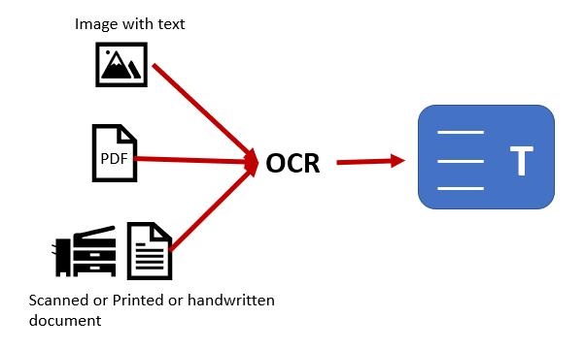
OCR Overview
Optical Character Recognition (OCR) is the mechanical or electronic conversion of images of typewritten or printed text into machine-encoded text.

Slide 4
Glossary
OCR: Optical Character Recognition
It is a technology that recognizes text within a digital image. Target typewritten text, only Glyph or character at a time.
OWR: Optical Word Recognition
Target typewritten text, only word at a time.
ICR: Intelligent Character Recognition
Target typewritten printed script or cursive text one glyph or character at a time. Usually involves machine learning.
IWR: Intelligent Word Recognition
Target typewritten printed script or cursive text word at a time. This is especially useful for language where glyphs are not separated in cursive script

Slide 5
UDScan – Use Cases
UDScan is a framework used for digitizing printed text so that it can be electronically edited, searched, stored more compactly, displayed online and used in machine processes such as Machine learning, Text to Speech and Text Mining
TODO

Slide 6
UDScan – Overview
TODO

Slide 7
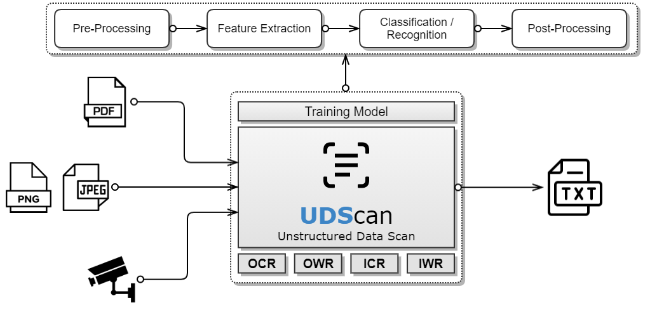
UDScan – Architecture

Slide 8
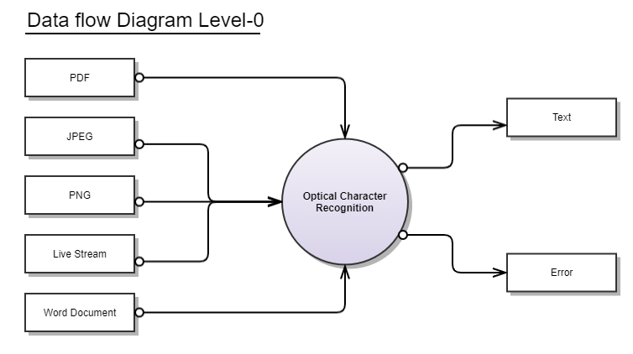
UDScan – Dataflow Diagram (Level-0)

Slide 9
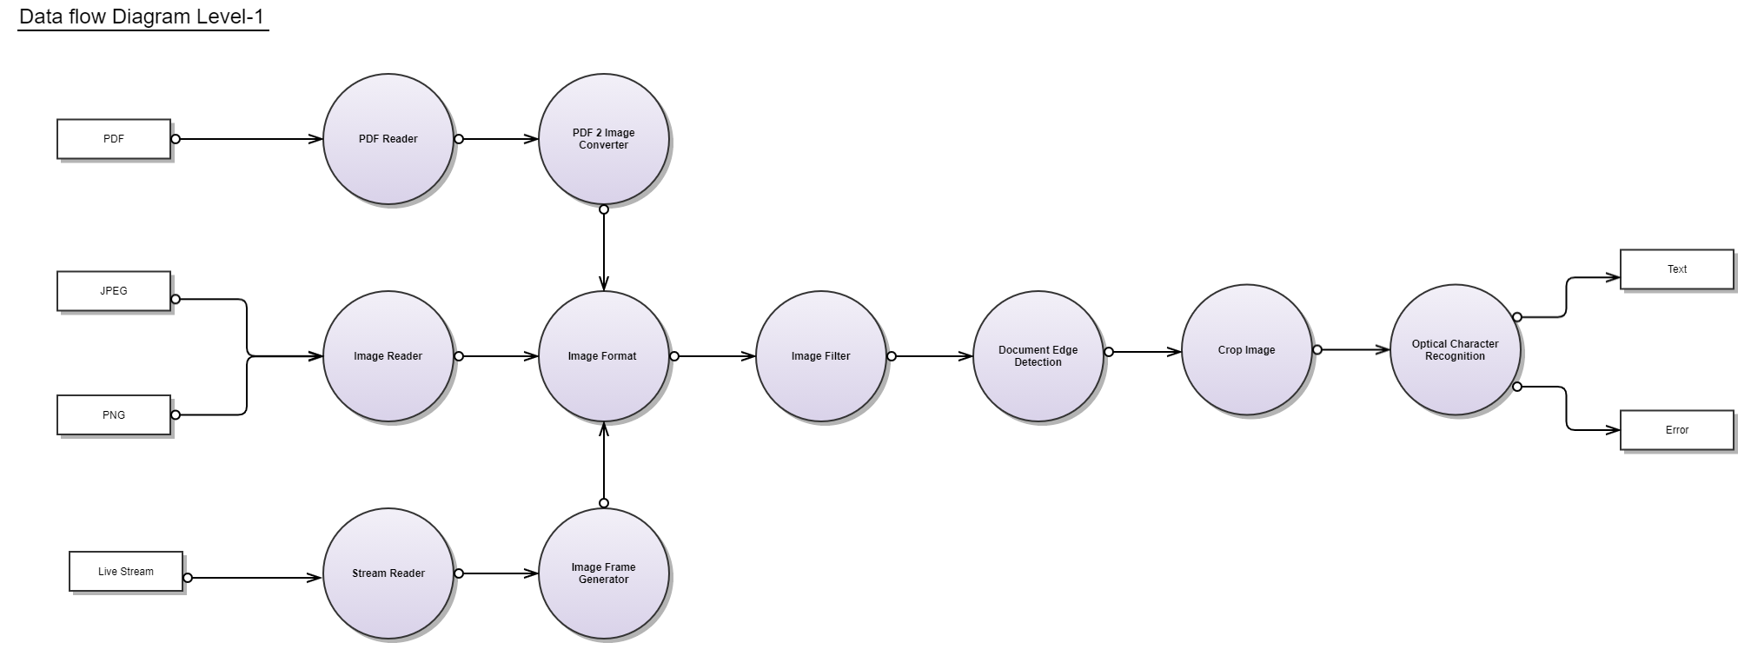
UDScan – Dataflow Diagram (Level-1)

Slide 10
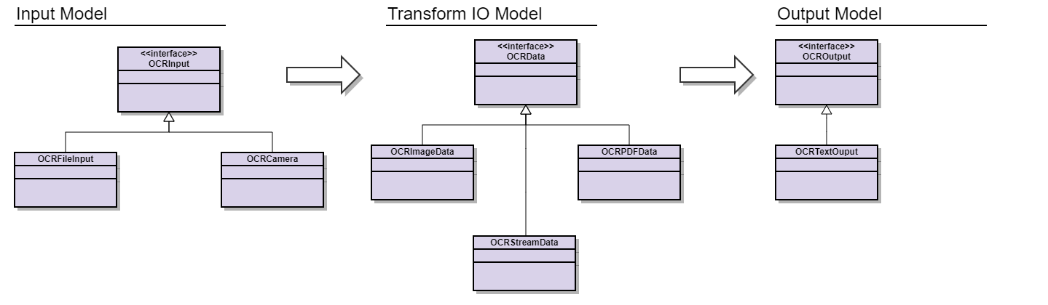
UDScan – Model Diagram

Slide 11
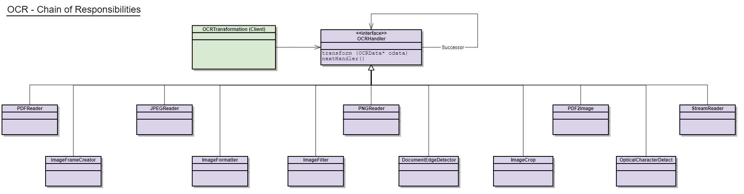
UDScan – Core Responsibilities

Slide 12
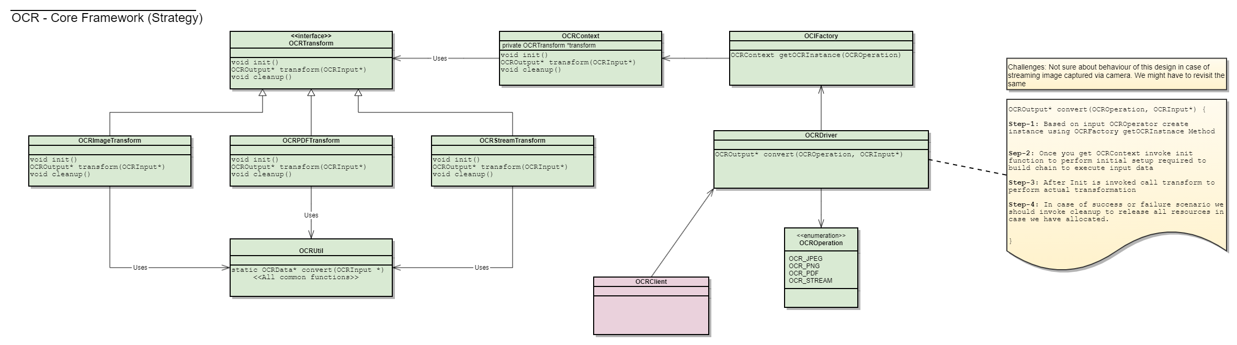
UDScan – Core Framework

Slide 13
UDScan – Features
TODO

Slide 14

UDScan – Technologies Used
Technology | Technology Overview | Alternative Considered | Reason

Slide 15
UDScan – What’s Next?
TODO

Slide 16
UDScan – Reference
Topic | Reference Link

Slide 17


